Slide 1
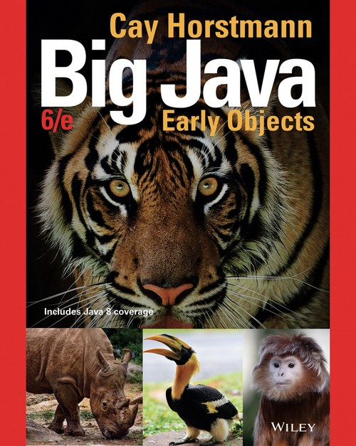
Chapter 9 – Inheritance

Slide 2
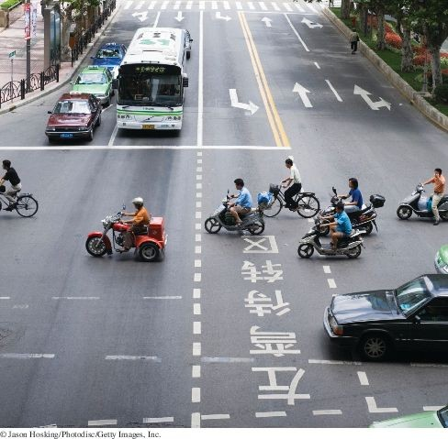
Chapter Goals
To learn about inheritance
To implement subclasses that inherit and override superclass methods To understand the concept of polymorphism
To be familiar with the common superclass Object and its methods

Slide 3
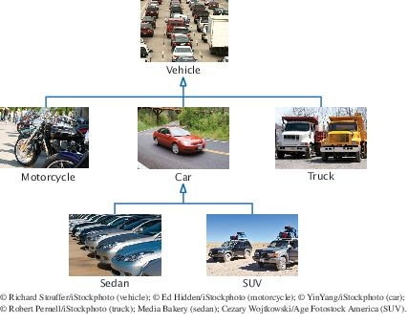
Inheritance Hierarchies
Inheritance: the relationship between a more general class (superclass) and a more specialized class (subclass).
The subclass inherits data and behavior from the superclass. Cars share the common traits of all vehicles
Example: the ability to transport people from one place to another
Figure 1 An Inheritance Hierarchy of Vehicle Classes

Slide 4
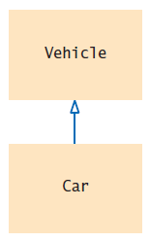
Inheritance Hierarchies
The class Car inherits from the class Vehicle
The Vehicle class is the superclass The Car class is the subclass
Figure 2 Inheritance Diagram

Slide 5
Inheritance Hierarchies
Inheritance lets you can reuse code instead of duplicating it. Two types of reuse
A subclass inherits the methods of the superclass
Because a car is a special kind of vehicle, we can use a Car object in algorithms that manipulate
Vehicle objects
The substitution principle:
You can always use a subclass object when a superclass object is expected.
A method that processes Vehicle objects can handle any kind of vehicle

Slide 6
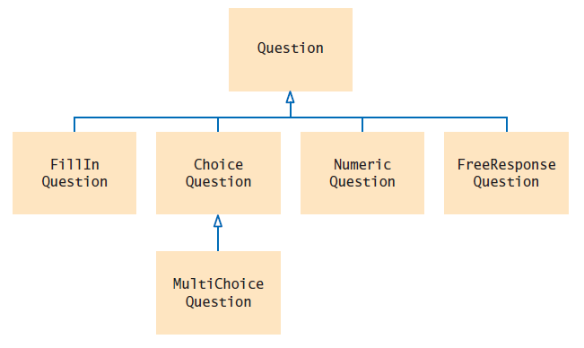
Inheritance Hierarchies
Figure 3 Inheritance Hierarchy of Question Types
Example: Computer-graded quiz
There are different kinds of questions
A question can display its text, and it can check whether a given response is a correct answer.
You can form subclasses of the Question class.

Slide 7
section_1/Question.java
1 /**
2 A question with a text and an answer.
3 */
4 public class Question
5 {
private String text;
private String answer;
8
9
10
11
12
13
14
15
16
17
18
19
20
21
22
23
24
25
26
27
28
29
30
31
32
/**
Constructs a question with empty question and answer.
*/
public Question()
{
text = ""; answer = "";
}
/**
Sets the question text.
@param questionText the text of this question
*/
public void setText(String questionText)
{
text = questionText;
}
/**
Sets the answer for this question.
@param correctResponse the answer
*/
public void setAnswer(String correctResponse)
{

Slide 8
section_1/QuestionDemo1.java
1 import java.util.Scanner;
2
3 /**
4 This program shows a simple quiz with one question.
5 */
6 public class QuestionDemo1
7 {
8 public static void main(String[] args)
9 {
10 Scanner in = new Scanner(System.in);
11
12
13
14
15
16
17
18
19
20
21 }
22
Question q = new Question();
q.setText("Who was the inventor of Java?"); q.setAnswer("James Gosling");
q.display(); System.out.print("Your answer: "); String response = in.nextLine();
System.out.println(q.checkAnswer(response));
}
Program Run:
Who was the inventor of Java? Your answer: James Gosling true

Slide 9
Self Check 9.1
Consider classes Manager and Employee. Which should be the superclass and which should be the subclass?
Answer: Because every manager is an employee but not the other way around, the Manager class is more specialized. It is the subclass, and Employee is the superclass.

Slide 10
Self Check 9.2
What are the inheritance relationships between classes BankAccount, CheckingAccount, and
SavingsAccount?
Answer: CheckingAccount and SavingsAccount both inherit from the more general class BankAccount.

Slide 11
Self Check 9.3
What are all the superclasses of the JFrame class? Consult the Java API documentation or Appendix D.
Answer: The classes Frame, Window, and Component in the java.awt package, and the class Object in the java.lang package.

Slide 12
Self Check 9.4
Consider the method doSomething(Car c). List all vehicle classes from Figure 1 whose objects
cannot be passed to this method.
Answer: Vehicle, Truck, Motorcycle

Slide 13
Self Check 9.5
Should a class Quiz inherit from the class Question? Why or why not?
Answer: It shouldn’t. A quiz isn’t a question; it has questions.

Slide 14
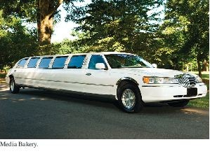
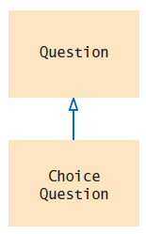
Implementing Subclasses
Like the manufacturer of a stretch limo, who starts with a regular car and modifies it, a programmer makes a subclass by modifying another class.
To get a ChoiceQuestion class, implement it as a subclass of Question
Specify what makes the subclass different from its superclass.
Subclass objects automatically have the instance variables that are declared in the superclass. Only declare instance variables that are not part of the superclass objects.
A subclass inherits all methods that it does not override.
Figure 4 The ChoiceQuestion Class is a Subclass of the Question
Class.

Slide 15
Implementing Subclasses
The subclass inherits all public methods from the superclass. You declare any methods that are new to the subclass.
You change the implementation of inherited methods if the inherited behavior is not appropriate.
Override a method: supply a new implementation for an inherited method

Slide 16
Implementing Subclasses
A ChoiceQuestion object differs from a Question object in three ways:
Its objects store the various choices for the answer. There is a method for adding answer choices.
The display method of the ChoiceQuestion class shows these choices so that the respondent can choose one of them.

Slide 17
Implementing Subclasses
The ChoiceQuestion class needs to spell out the three differences:
public class ChoiceQuestion extends Question
{
// This instance variable is added to the subclass private ArrayList<String> choices;
// This method is added to the subclass
public void addChoice(String choice, boolean correct) { . . . }
// This method overrides a method from the superclass public void display() { . . . }
}
The extends reserved word indicates that a class inherits from a superclass.

Slide 18
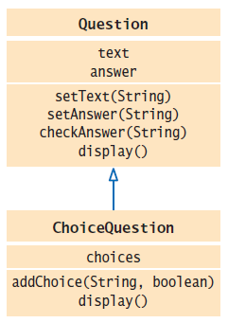
Implementing Subclasses
UML of ChoiceQuestion and Question
Figure 5 The ChoiceQuestion Class Adds an Instance Variable and a Method, and Overrides a Method

Slide 19
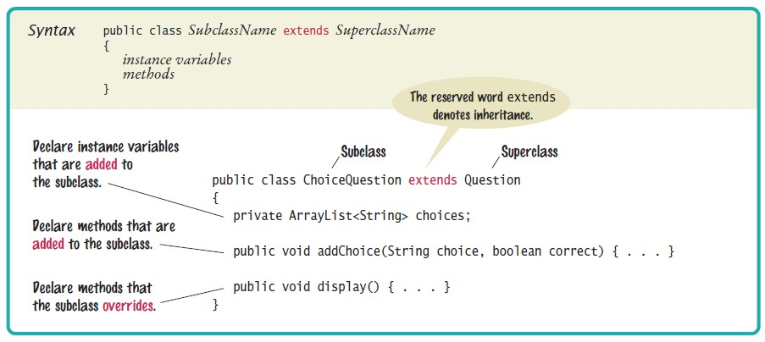
Syntax 9.1 Subclass Declaration

Slide 20
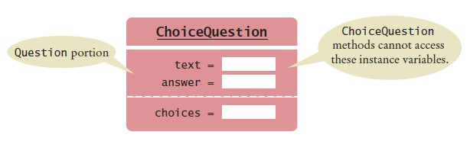
Implementing Subclasses
A ChoiceQuestion object
You can call the inherited methods on a subclass object:
choiceQuestion.setAnswer("2");
The private instance variables of the superclass are inaccessible.
The ChoiceQuestion methods cannot directly access the instance variable
answer.
ChoiceQuestion methods must use the public interface of the Question
class to access its private data.

Slide 21
Implementing Subclasses
Adding a new method: addChoice
public void addChoice(String choice, boolean correct)
{
choices.add(choice); if (correct)
{
// Convert choices.size() to string
String choiceString = "" + choices.size(); setAnswer(choiceString);
}
}
addChoice method can not just access the answer variable in the superclass: It must use the setAnswer method
Invoke setAnswer on the implicit parameter:
setAnswer(choiceString);
OR
this.setAnswer(choiceString);

Slide 22
Self Check 9.6
Suppose q is an object of the class Question and cq an object of the class ChoiceQuestion. Which of the following calls are legal?
q.setAnswer(response)
cq.setAnswer(response)
q.addChoice(choice, true)
cq.addChoice(choice, true)
Answer: a, b, d

Slide 23
Self Check 9.7
Suppose the class Employee is declared as follows:
public class Employee
{
private String name; private double baseSalary;
public void setName(String newName) { . . . }
public void setBaseSalary(double newSalary) { . . . } public String getName() { . . . }
public double getSalary() { . . . }
}
Declare a class Manager that inherits from the class Employee and adds an instance variable bonus for storing a salary bonus. Omit constructors and methods.
Answer:
public class Manager extends Employee
{
private double bonus;
// Constructors and methods omitted
}

Slide 24
Self Check 9.8
Which instance variables does the Manager class from Self Check 7 have?
Answer: name, baseSalary, and bonus

Slide 25
Self Check 9.9
In the Manager class, provide the method header (but not the implementation) for a method that overrides the getSalary method from the class Employee.
Answer:
public class Manager extends Employee
{
. . .
public double getSalary() { . . . }
}

Slide 26
Self Check 9.10
Which methods does the Manager class from Self Check 9 inherit?
Answer: getName, setName, setBaseSalary

Slide 27
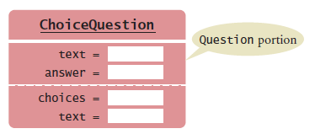
Common Error: Replicating Instance Variables from the Superclass
A subclass has no access to the private instance variables of the superclass:
public ChoiceQuestion(String questionText)
{
text = questionText; // Error—tries to access private superclass variable
}
Beginner's error: "solve" this problem by adding another instance variable with same name
Error!
public class ChoiceQuestion extends Question
{
private ArrayList<String> choices; private String text; // Don’t!
. . .
}
The constructor compiles, but it doesn’t set the correct text!
The ChoiceQuestion constructor should call the setText method of the Question class.

Slide 28
Overriding Methods
If you are not satisfied with the behavior of an inherited method,
you override it by specifying a new implementation in the subclass.
An overriding method can extend or replace the functionality of the superclass method.
The display method of the ChoiceQuestion class needs to:
Display the question text. Display the answer choices.

Slide 29
Overriding Methods
Problem: ChoiceQuestion's display method can’t access the text variable of the superclass directly because it is private.
Solution: It can call the display method of the superclass, by using the reserved word super
public void display()
{
// Display the question text super.display(); // OK
// Display the answer choices
. . .
}
super is a reserved word that forces execution of the superclass method.

Slide 30
section_3/QuestionDemo2.java
1 import java.util.Scanner;
2
3 /**
4 This program shows a simple quiz with two choice questions.
5 */
6 public class QuestionDemo2
7 {
8 public static void main(String[] args)
9 {
ChoiceQuestion first = new ChoiceQuestion();
first.setText("What was the original name of the Java language?");
first.addChoice("*7", false);
first.addChoice("Duke", false);
first.addChoice("Oak", true);
first.addChoice("Gosling", false);
16
17
18
19
20
21
22
23
24
25
26
27
28
29
30
31
32
33
34
35
ChoiceQuestion second = new ChoiceQuestion();
second.setText("In which country was the inventor of Java born?"); second.addChoice("Australia", false);
second.addChoice("Canada", true); second.addChoice("Denmark", false); second.addChoice("United States", false);
presentQuestion(first); presentQuestion(second);
}
/**
Presents a question to the user and checks the response.
@param q the question
*/
public static void presentQuestion(ChoiceQuestion q)
{
q.display(); System.out.print("Your answer: ");

Slide 31
section_3/ChoiceQuestion.java
1 import java.util.ArrayList;
2
3 /**
4 A question with multiple choices.
5 */
6 public class ChoiceQuestion extends Question
7 {
8 private ArrayList<String> choices;
9
10
11
12
13
14
15
16
17
18
19
20
21
22
23
24
25
26
27
28
/**
Constructs a choice question with no choices.
*/
public ChoiceQuestion()
{
choices = new ArrayList<String>();
}
/**
Adds an answer choice to this question.
@param choice the choice to add
@param correct true if this is the correct choice, false otherwise
*/
public void addChoice(String choice, boolean correct)
{
choices.add(choice); if (correct)
{
// Convert choices.size() to string

Slide 32
Program Run:
What was the original name of the Java language? 1: *7
2: Duke
3: Oak
4: Gosling
Your answer: *7 false
In which country was the inventor of Java born?
1: Australia
2: Canada
3: Denmark
4: United States
Your answer: 2 true

Slide 33
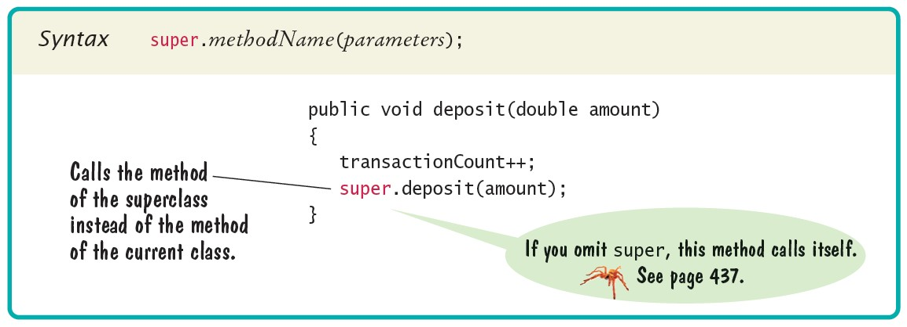
Syntax 9.2 Calling a Superclass Method

Slide 34
Self Check 9.11
What is wrong with the following implementation of the display method?
public class ChoiceQuestion
{
. . .
public void display()
{
System.out.println(text);
for (int i = 0; i < choices.size(); i++)
{
int choiceNumber = i + 1;
System.out.println(choiceNumber + ": " + choices.get(i));
}
}
}
Answer: The method is not allowed to access the instance variable text from the superclass.

Slide 35
Self Check 9.12
What is wrong with the following implementation of the display method?
public class ChoiceQuestion
{
. . .
public void display()
{
this.display();
for (int i = 0; i < choices.size(); i++)
{
int choiceNumber = i + 1;
System.out.println(choiceNumber + ": " + choices.get(i));
}
}
}
Answer: The type of the this reference is ChoiceQuestion. Therefore, the
display method of ChoiceQuestion is selected, and the method calls itself.

Slide 36
Self Check 9.13
Look again at the implementation of the addChoice method that calls the setAnswer method of the superclass. Why don’t you need to call super.setAnswer?
Answer: Because there is no ambiguity. The subclass doesn’t have a
setAnswer method.

Slide 37
Self Check 9.14
In the Manager class of Self Check 7, override the getName method so that managers have a * before their name (such as *Lin, Sally).
Answer:
public String getName()
{
return "*" + super.getName();
}

Slide 38
Self Check 9.15
In the Manager class of Self Check 9, override the getSalary method so that it returns the sum of the salary and the bonus.
Answer:
public double getSalary()
{
return super.getSalary() + bonus;
}

Slide 39
Common Error: Accidental Overloading
Overloading: when two methods have the same name but different parameter types.
Overriding: when a subclass method provides an implementation of a superclass method whose parameter variables have the same types.
When overriding a method, the types of the parameter variables must match exactly.

Slide 40
Common Error: Forgetting to Use super When Invoking Superclass Method
Use super when extending Employee functionality to Manager class
public class Manager {
.. .
public double getSalary() {
double baseSalary = getSalary();
// Error: should be super.getSalary() return baseSalary + bonus;
}
}

Slide 41
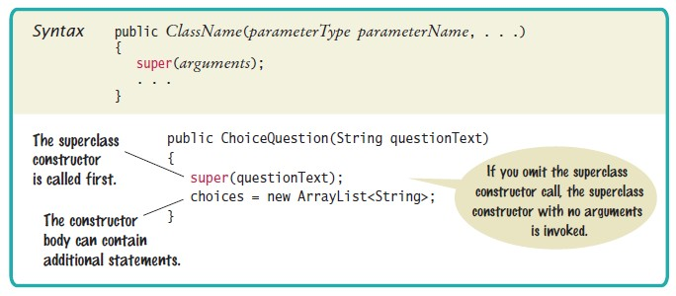
Syntax 9.3 Constructor with Superclass Initializer

Slide 42
Polymorphism
Problem: to present both Question and ChoiceQuestion with the same program.
We do not need to know the exact type of the question
We need to display the question
We need to check whether the user supplied the correct answer
The Question superclass has methods for displaying and checking.
We can simply declare the parameter variable of the presentQuestion
method to have the type Question:
public static void presentQuestion(Question q)
{
q.display(); System.out.print("Your answer: ");
Scanner in = new Scanner(System.in);
String response = in.nextLine(); System.out.println(q.checkAnswer(response));
}

Slide 43
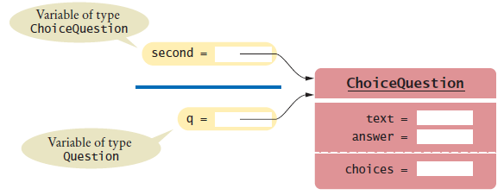
Polymorphism - continued
We can substitute a subclass object whenever a superclass object is expected:
ChoiceQuestion second = new ChoiceQuestion();
. . .
presentQuestion(second); // OK to pass a ChoiceQuestion
When the presentQuestion method executes -
The object references stored in second and q refer to the same object The object is of type ChoiceQuestion
Figure 7 Variables of Different Types Referring to the Same Object

Slide 44
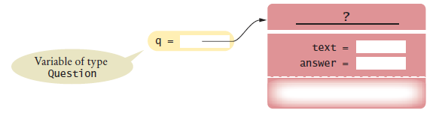

Polymorphism - continued
The variable q knows less than the full story about the object to which it refers
Figure 8 A Question Reference Can Refer to an Object of Any Subclass of Question
In the same way that vehicles can differ in their method of locomotion, polymorphic objects carry out tasks in different ways.

Slide 45
Polymorphism - continued
When the virtual machine calls an instance method -
It locates the method of the implicit parameter’s class. This is called dynamic method lookup
Dynamic method lookup allows us to treat objects of different classes in a uniform way.
This feature is called polymorphism.
We ask multiple objects to carry out a task, and each object does so in its own way.
Polymorphism means “having multiple forms”
It allows us to manipulate objects that share a set of tasks, even though the tasks are executed in different ways.

Slide 46
section_4/QuestionDemo3.java
1 import java.util.Scanner;
2
3 /**
4 This program shows a simple quiz with two question types.
5 */
6 public class QuestionDemo3
7 {
8 public static void main(String[] args)
9 {
Question first = new Question();
first.setText("Who was the inventor of Java?");
first.setAnswer("James Gosling");
13
14
15
16
17
18
19
20
21
22
23
24
25
26
27
28
29
30
31
32
33
34
35
ChoiceQuestion second = new ChoiceQuestion();
second.setText("In which country was the inventor of Java born?"); second.addChoice("Australia", false);
second.addChoice("Canada", true); second.addChoice("Denmark", false); second.addChoice("United States", false);
presentQuestion(first); presentQuestion(second);
}
/**
Presents a question to the user and checks the response.
@param q the question
*/
public static void presentQuestion(Question q)
{
q.display(); System.out.print("Your answer: ");
Scanner in = new Scanner(System.in); String response = in.nextLine();
System.out.println(q.checkAnswer(response));

Slide 47
Program Run:
Who was the inventor of Java? Your answer: Bjarne Stroustrup false
In which country was the inventor of Java born? 1: Australia
2: Canada
3: Denmark
4: United States
Your answer: 2 true

Slide 48
Self Check 9.16
Assuming SavingsAccount is a subclass of BankAccount, which of the following code fragments are valid in Java?
BankAccount account = new SavingsAccount();
SavingsAccount account2 = new BankAccount();
BankAccount account = null;
SavingsAccount account2 = account;
Answer: a only.

Slide 49
Self Check 9.17
If account is a variable of type BankAccount that holds a non-null reference, what do you know about the object to which account refers?
Answer: It belongs to the class BankAccount or one of its subclasses.

Slide 50
Self Check 9.18
Declare an array quiz that can hold a mixture of Question and ChoiceQuestion objects.
Answer:
Question[] quiz = new Question[SIZE];

Slide 51
Self Check 9.19
Consider the code fragment
ChoiceQuestion cq = . . .; // A non-null value cq.display();
Which actual method is being called?
Answer: You cannot tell from the fragment—cq may be initialized with an object of a subclass of ChoiceQuestion. The display method of whatever object cq references is invoked.

Slide 52
Self Check 9.20
Is the method call Math.sqrt(2) resolved through dynamic method lookup?
Answer: No. This is a static method of the Math class. There is no implicit parameter object that could be used to dynamically look up a method.

Slide 53
Object: The Cosmic Superclass
Every class defined without an explicit extends clause automatically extend
Object:
The class Object is the direct or indirect superclass of every class in Java. Some methods defined in Object:
toString - which yields a string describing the object
equals - which compares objects with each other
hashCode - which yields a numerical code for storing the object in a set

Slide 54
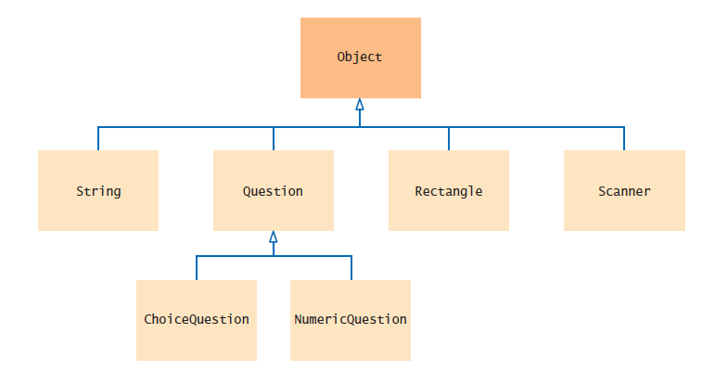
Object: The Cosmic Superclass
Figure 9 The Object Class Is the Superclass of Every Java Class

Slide 55
Overriding the toString Method
Returns a string representation of the object Useful for debugging:
Rectangle box = new Rectangle(5, 10, 20, 30); String s = box.toString();
// Sets s to "java.awt.Rectangle[x=5,y=10,width=20,height=30]"
toString is called whenever you concatenate a string with an object:
"box=" + box;
// Result: "box=java.awt.Rectangle[x=5,y=10,width=20,height=30]"
The compiler can invoke the toString method, because it knows that every object has a toString method:
Every class extends the Object class which declares toString

Slide 56
Overriding the toString Method
Object.toString prints class name and the hash code of the object:
BankAccount momsSavings = new BankAccount(5000); String s = momsSavings.toString();
// Sets s to something like "BankAccount@d24606bf"
Override the toString method in your classes to yield a string that describes the object’s state.
public String toString()
{
return "BankAccount[balance=" + balance + "]";
}
This works better:
BankAccount momsSavings = new BankAccount(5000);
String s = momsSavings.toString(); // Sets s to "BankAccount[balance=5000]"

Slide 57

Overriding the equals Method
equals method checks whether two objects have the same content:
if (stamp1.equals(stamp2)) . . .
// Contents are the same
== operator tests whether two references are identical - referring to the same object:
if (stamp1 == stamp2) . . .
// Objects are the same

Slide 58
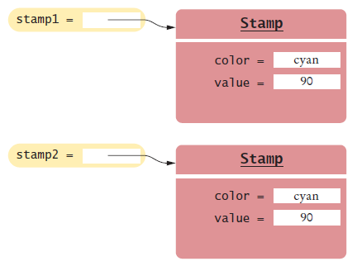
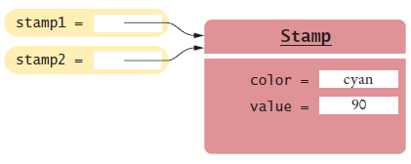
Overriding the equals Method
Figure 10 Two References to Equal Objects
Figure 11 Two References to the Same Object

Slide 59
Overriding the equals Method
To implement the equals method for a Stamp class -
Override the equals method of the Object class:
public class Stamp
{
private String color; private int value;
. . .
public boolean equals(Object otherObject)
{
. . .
}
. . .
}
Cannot change parameter type of the equals method - it must be Object Cast the parameter variable to the class Stamp instead:
Stamp other = (Stamp) otherObject;

Slide 60
Overriding the equals Method
After casting, you can compare two Stamps
public boolean equals(Object otherObject)
{
Stamp other = (Stamp) otherObject; return color.equals(other.color)
&& value == other.value;
}
The equals method can access the instance variables of any Stamp object. The access other.color is legal.

Slide 61
The instanceof Operator
It is legal to store a subclass reference in a superclass variable:
ChoiceQuestion cq = new ChoiceQuestion(); Question q = cq; // OK
Object obj = cq; // OK
Sometimes you need to convert from a superclass reference to a subclass reference.
If you know a variable of type Object actually holds a Question reference, you can cast
Question q = (Question) obj
If obj refers to an object of an unrelated type, "class cast" exception is thrown. The instanceof operator tests whether an object belongs to a particular type.
obj instanceof Question
Using the instanceof operator, a safe cast can be programmed as follows:
if (obj instanceof Question)
{
Question q = (Question) obj;
}

Slide 62
Self Check 9.21
Why does the call
System.out.println(System.out);
produce a result such as java.io.PrintStream@7a84e4?
Answer: Because the implementor of the PrintStream class did not supply a
toString method.

Slide 63
Self Check 9.22
Will the following code fragment compile? Will it run? If not, what error is reported?
Object obj = "Hello"; System.out.println(obj.length());
Answer: The second line will not compile. The class Object does not have a method length.

Slide 64
Self Check 9.23
Will the following code fragment compile? Will it run? If not, what error is reported?
Object obj = "Who was the inventor of Java?"; Question q = (Question) obj;
q.display();
Answer: The code will compile, but the second line will throw a class cast exception because Question is not a superclass of String.

Slide 65
Self Check 9.24
Why don’t we simply store all objects in variables of type Object?
Answer: There are only a few methods that can be invoked on variables of type
Object.

Slide 66
Self Check 9.25
Assuming that x is an object reference, what is the value of x instanceof Object?
Answer: The value is false if x is null and true otherwise.

